Slide 1
Programming Language II CSE-215
Prof. Dr. Mohammad Abu Yousuf
yousuf@juniv.edu

Slide 2
Multithreaded Programming-3

Slide 3
Thread Priorities
Thread priorities are used by the thread scheduler to decide when each thread should be allowed to run.
In theory, higher-priority threads get more CPU time than lower-priority threads.
A higher-priority thread can also preempt a lower-priority one. For instance, when a lower-priority thread is running and a higher-priority thread resumes (from sleeping or waiting on I/O, for example), it will preempt the lower-priority thread.

Slide 4
To set a thread’s priority, use the setPriority( ) method, which is a member of Thread. This is its general form:
final void setPriority(int level)
Here, level specifies the new priority setting for the calling thread. The value of level must be within the range MIN_PRIORITY and MAX_PRIORITY. Currently, these values are 1 and 10, respectively.
To return a thread to default priority, specify NORM_PRIORITY, which is currently 5.

Slide 5
You can obtain the current priority setting by calling the getPriority( ) method of Thread, shown here:
final int getPriority( )
getPriority() method is used to get the priority of the thread.

Slide 6
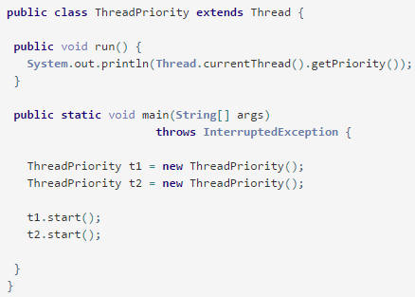
Example #1 : Default Thread Priority

Slide 7
Output of previous program:
5
5
Default priority of the thread is 5.
Each thread has normal priority at the time of creation. We can change or modify the thread priority in the following example 2.

Slide 8
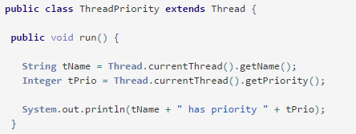
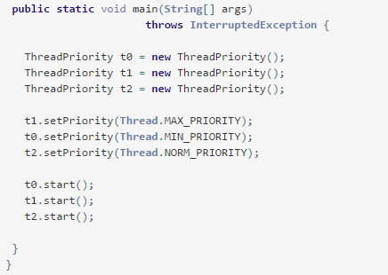
Example #2 : Setting Priority

Slide 9
Output of previous program:
Thread-0 has priority 1
Thread-2 has priority 5
Thread-1 has priority 10

Slide 10
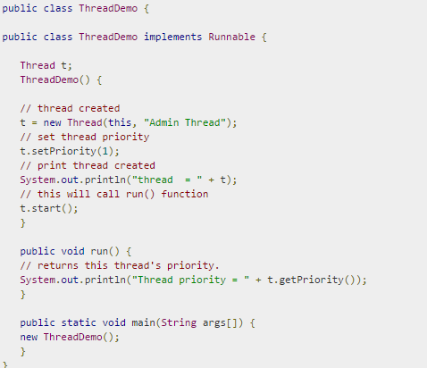

Slide 11
Output of previous program:
thread = Thread[Admin Thread,1,main] Thread priority = 1

Slide 12
Daemon Thread in Java
Daemon thread in java is a service provider thread that provides services to the user thread. Its life depend on the mercy of user threads i.e. when all the user threads dies, JVM terminates this thread automatically.
Points to remember for Daemon Thread in Java:
It provides services to user threads for background supporting tasks such as garbage collection (gc) etc. It has no role in life than to serve user threads.
Its life depends on user threads.
It is a low priority thread.

Slide 13
Methods for Java Daemon thread by Thread class
The java.lang.Thread class provides two methods for java daemon thread.
No. | Method | Description
1) | public void setDaemon(boolean status) | is used to mark the current thread as daemon thread or user thread.
2) | public boolean isDaemon() | is used to check that current is daemon.

Slide 14
public class TestDaemonThread1 extends Thread{
public void run(){
if(Thread.currentThread().isDaemon()){//checking for daemon thread
System.out.println("daemon thread work");
}
else{
System.out.println("user thread work");
}
}
public static void main(String[] args){
TestDaemonThread1 t1=new TestDaemonThread1();//creating thread
TestDaemonThread1 t2=new TestDaemonThread1();
TestDaemonThread1 t3=new TestDaemonThread1();
t1.setDaemon(true);//now t1 is daemon thread
t1.start();//starting threads
t2.start();
t3.start();
}
}
Output-
daemon thread work
user thread work
user thread work

Slide 15
Methods for Java Daemon thread by Thread class
Note: If you want to make a user thread as Daemon, it must not be started otherwise it will throw IllegalThreadStateException.
class TestDaemonThread2 extends Thread{
public void run(){
System.out.println("Name: "+Thread.currentThread().getName());
System.out.println("Daemon: "+Thread.currentThread().isDaemon());
}
public static void main(String[] args){
TestDaemonThread2 t1=new TestDaemonThread2();
TestDaemonThread2 t2=new TestDaemonThread2();
t1.start();
t1.setDaemon(true);//will throw exception here
t2.start();
}
}
Output: exception in thread main: java.lang.IllegalThreadStateException

Slide 16
Synchronization
When we start two or more threads within a program, there may be a situation when multiple threads try to access the same resource and finally they can produce unforeseen result due to concurrency issue.
For example if multiple threads try to write within a same file then they may corrupt the data because one of the threads can override data or while one thread is opening the same file at the same time another thread might be closing the same file.

Slide 17
Synchronization
So there is a need to synchronize the action of multiple threads and make sure that only one thread can access the resource at a given point in time.
When two or more threads need access to a shared resource, they need some way to ensure that the resource will be used by only one thread at a time. The process by which this is achieved is called synchronization.

Slide 18
Synchronization
This is implemented using a concept called monitors. Each object in Java is associated with a monitor, which a thread can lock or unlock. Only one thread at a time may hold a lock on a monitor.
When a thread acquires a lock, it is said to have entered the monitor. All other threads attempting to enter the locked monitor will be suspended until the first thread exits the monitor.
These other threads are said to be waiting for the monitor. A thread that owns a monitor can reenter the same monitor if it so desires.

Slide 19
class Table{
void printTable(int n){//method not synchronized
for(int i=1;i<=5;i++){
System.out.println(n*i);
try{
Thread.sleep(400);
}catch(Exception e){System.out.println(e);}
}
}
} //1
class MyThread1 extends Thread{
Table t;
MyThread1(Table t){
this.t=t;
}
public void run(){
t.printTable(5);
} }
class MyThread2 extends Thread{
Table t;
MyThread2(Table t){
this.t=t;
}
public void run(){
t.printTable(100);
} } //2
class TestSynchronization1{
public static void main(String args[]){
Table obj = new Table();//only one object
MyThread1 t1=new MyThread1(obj);
MyThread2 t2=new MyThread2(obj);
t1.start();
t2.start();
}
} //3
Example 1:
Multithreading example without Synchronization:

Slide 20
Output:
5
100
10
200
15
300
20
400
25
500
Example 1:
Multithreading example without Synchronization:

Slide 21
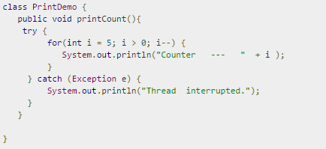
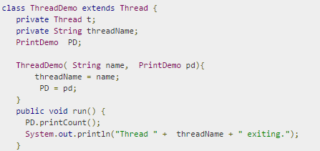
Example 2:
Multithreading example without Synchronization:

Slide 22
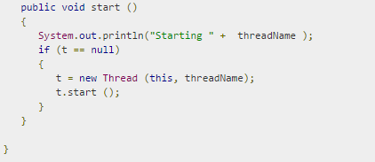
Multithreading example without Synchronization:
(Cont…)

Slide 23
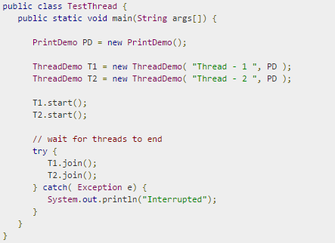
Multithreading example without Synchronization:
(Cont…)

Slide 24
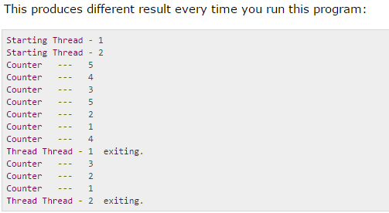

Slide 25
Two ways of synchronization
You can synchronize your code in either of two ways. Both involve the use of the synchronized keyword, and both are examined here.
1. Using The synchronized statement or block
2. Using Synchronized Methods

Slide 26
Two ways of synchronization Using The synchronized statement or block
You keep shared resources within this block. Following is the general form of the synchronized statement:
This is the general form of the synchronized statement:
synchronized(object) {
// statements to be synchronized
}
Here, object is a reference to the object being synchronized.
A synchronized block ensures that a call to a method that is a member of object occurs only after the current thread has successfully entered object’s monitor.

Slide 27
Two ways of synchronization Using Java synchronized method
If you declare any method as synchronized, it is known as synchronized method.
Synchronized method is used to lock an object for any shared resource.
When a thread invokes a synchronized method, it automatically acquires the lock for that object and releases it when the thread completes its task.

Slide 28
//example of java synchronized method
class Table{
synchronized void printTable(int n){//synchronized method
for(int i=1;i<=5;i++){
System.out.println(n*i);
try{
Thread.sleep(400);
}catch(Exception e){System.out.println(e);}
}
} } //1
class MyThread1 extends Thread{
Table t;
MyThread1(Table t){
this.t=t;
}
public void run(){
t.printTable(5);
} }
class MyThread2 extends Thread{
Table t;
MyThread2(Table t){
this.t=t;
}
public void run(){
t.printTable(100);
} } //2
public class TestSynchronization2{
public static void main(String args[]){
Table obj = new Table();//only one object
MyThread1 t1=new MyThread1(obj);
MyThread2 t2=new MyThread2(obj);
t1.start();
t2.start();
}
} //3
Example 1:
Multithreading example with Synchronization: Using synchronized method

Slide 29
Output:
5
10
15
20
25
100
200
300
400
500
Example 1:
Multithreading example with Synchronization:

Slide 30
class Table{
void printTable(int n){
synchronized(this){//synchronized block
for(int i=1;i<=5;i++){
System.out.println(n*i);
try{
Thread.sleep(400);
}catch(Exception e){System.out.println(e);}
}
}
}//end of the method
}
class MyThread1 extends Thread{
Table t;
MyThread1(Table t){
this.t=t;
}
public void run(){
t.printTable(5);
} }
class MyThread2 extends Thread{
Table t;
MyThread2(Table t){
this.t=t;
}
public void run(){
t.printTable(100);
} }
public class TestSynchronizedBlock1{
public static void main(String args[]){
Table obj = new Table();//only one object
MyThread1 t1=new MyThread1(obj);
MyThread2 t2=new MyThread2(obj);
t1.start();
t2.start();
}
}
Example 1:
Multithreading example with Synchronization: Using synchronized block

Slide 31
Output:
5
10
15
20
25
100
200
300
400
500
Example 1:
Multithreading example with Synchronization:

Slide 32
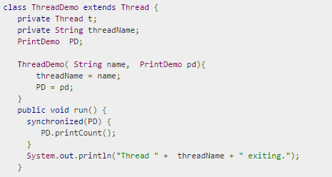
Example 2:
Multithreading example with Synchronization:
The program is done by Using The synchronized statement or block

Slide 33
Multithreading example with Synchronization:
(Cont…)

Slide 34
Multithreading example with Synchronization:
(Cont…)

Slide 35
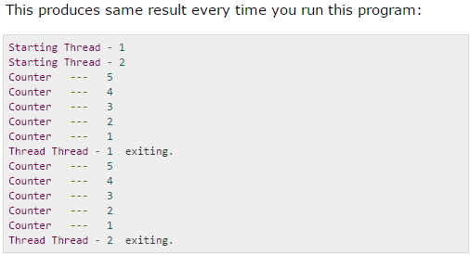

Slide 36
Difference between join() and synchronization
Thread.join() waits for the thread to completely finish, whereas a synchronized block can be used to prevent two threads from executing the same piece of code at the same time. It's hard to advise when to use one over the other in general, since they serve different purposes.
Don't think of synchronized as waiting for anything. The purpose of synchronized is to keep different threads from messing with the same data at the same time. It will wait if it has to, but that's always the less desirable outcome: In a perfect world, there would never be contention for the lock. When we call join(), on the other hand, that's because we want to wait. Thread A calls B.join() when there's nothing left that A can do until B is finished.

Slide 37
Thank you

